Slide 1
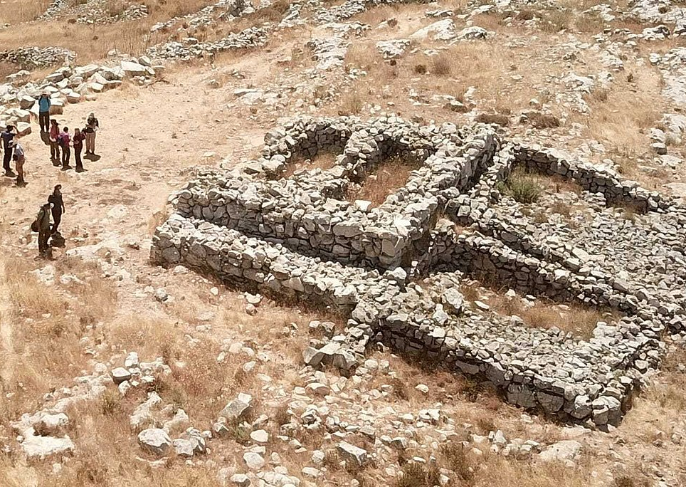
The Altar of Sacrifice

Slide 2
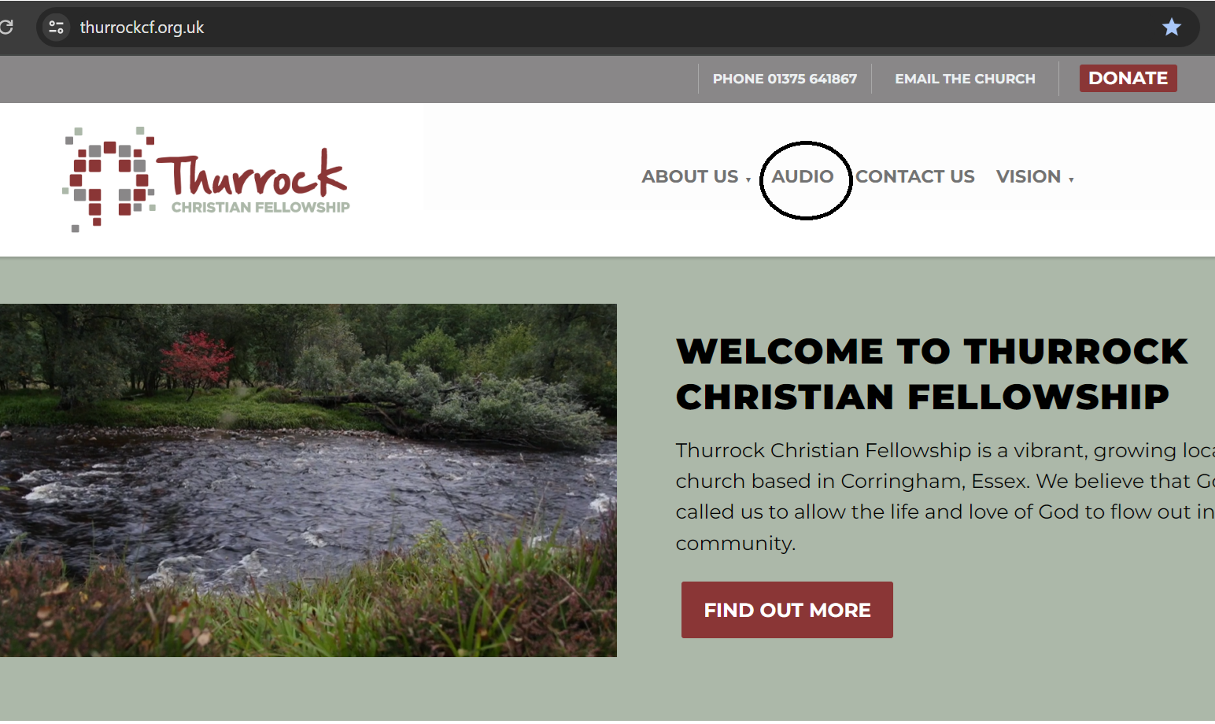
Altars an Introduction
Sunny
Promises
Glenda
Prayer
Andy
Provision
John
Praise
Gillian
Peace & Fellowship
David
Worship
Andy

Slide 3
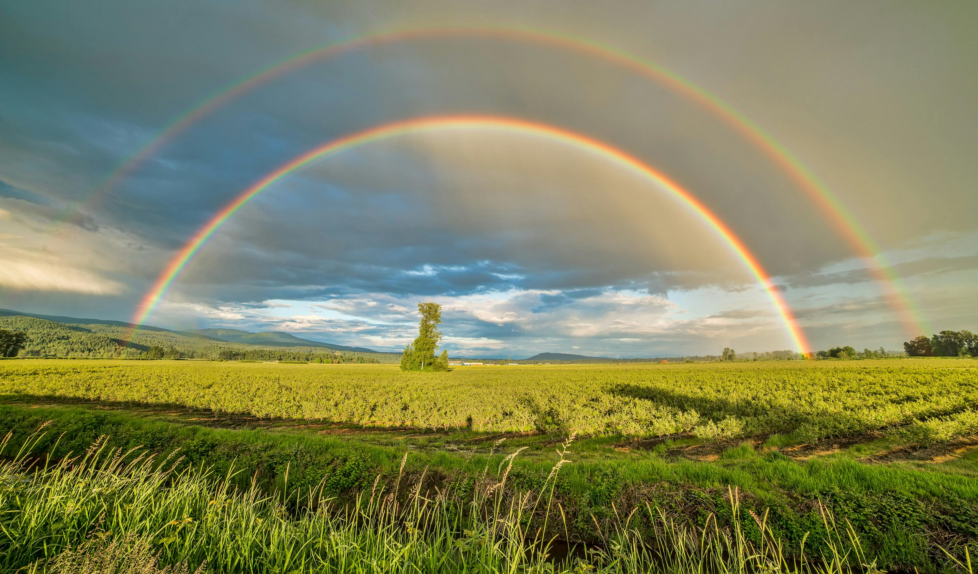
What is the earliest biblical example of an altar of sacrifice?
Noah …..But Cain and Able?
Response to Deliverance
Pleased God
Promise from God

Slide 4
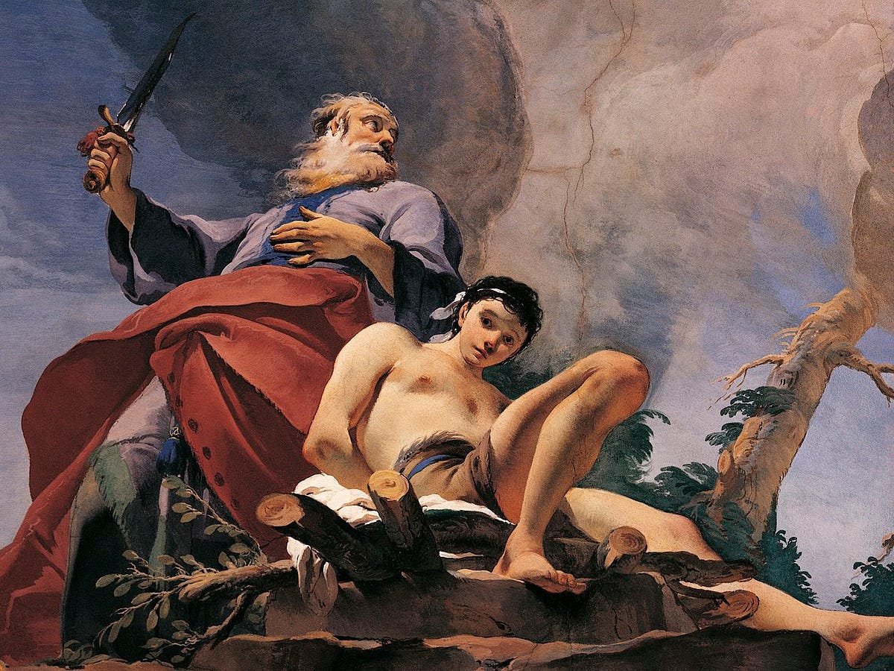
Abraham and the Sacrifice of Isaac
Typology / Paradigm / Prophecy is Pattern
Only Beloved Son
Named by YHWH
Loved His Father
Burnt offering
Offered up
Carried Wood
Father’s Fire
Sacrificial Lamb
Head in Thorns
Submitted to Will
Trusted Father
Placed on Wood
Silent
Returned to Bride

Slide 5
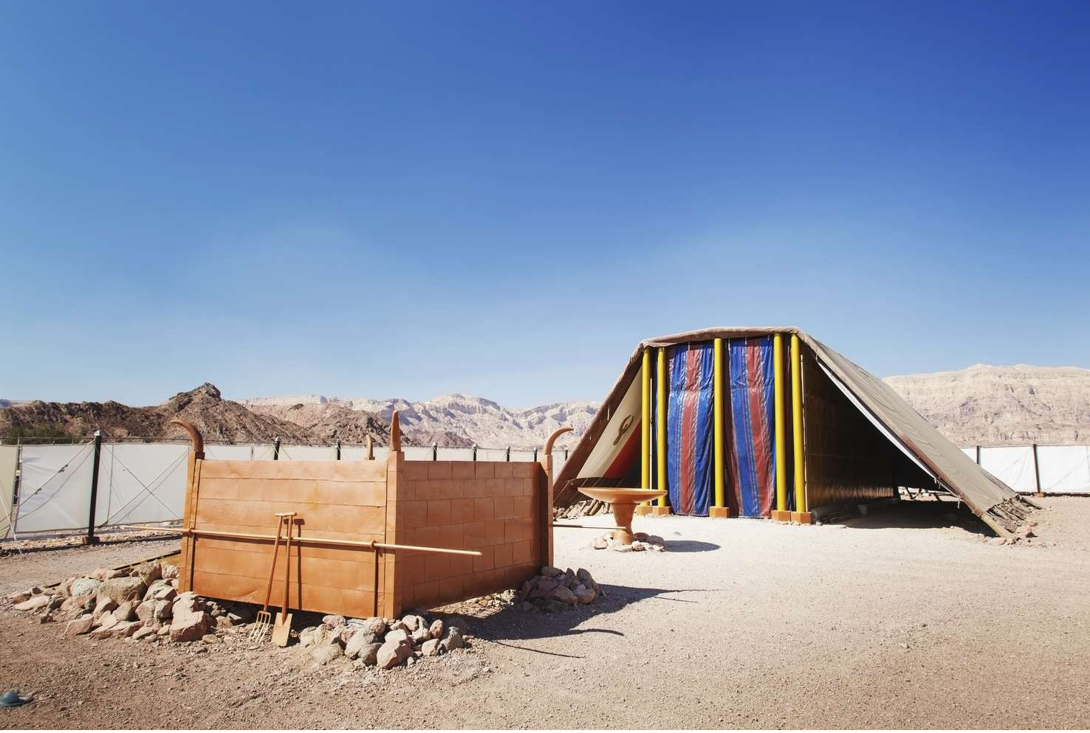
How was the Bronze altar of the Tabernacle used?

Slide 6
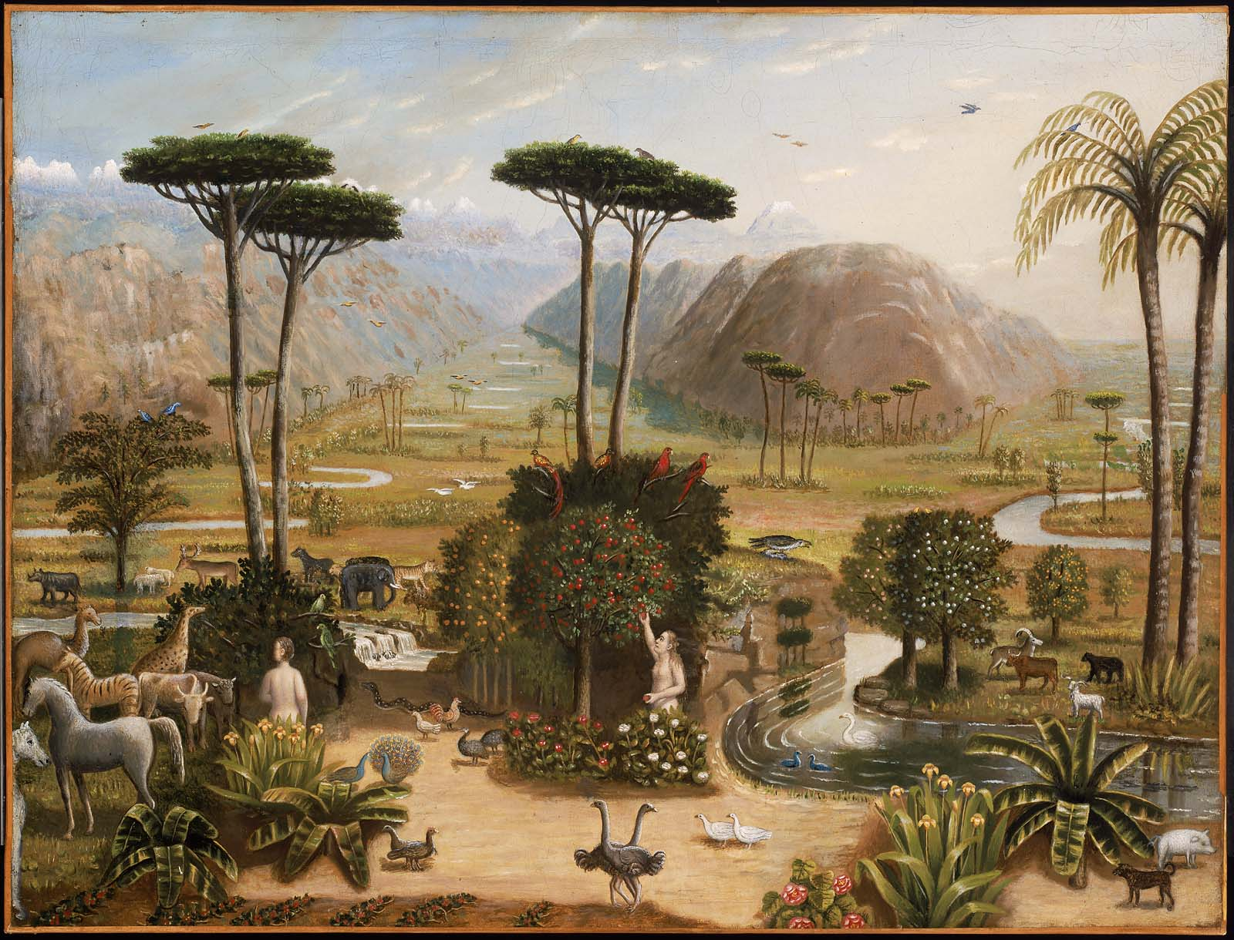
Why all those different sacrifices?
God wants a Family
One to Love Him
A Shared Space
Presence of God
God Loves His Family

Slide 7
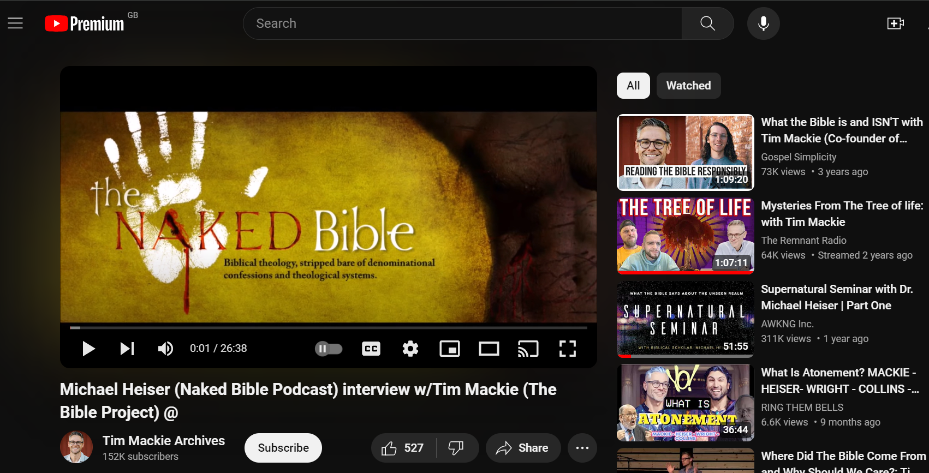
Why some sacrifices burned, some eaten, and the blood used in different ways?
A Bowl of Life
Sprinkled with Hyssop

Slide 8
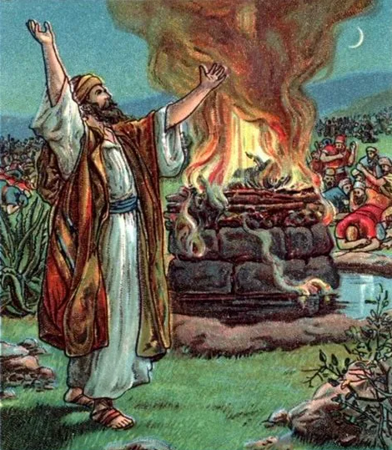
Elijah’s Altar
How did Elijah’s use of an altar prove that YHWH was God?
12 Stones
Trench Water
A Bolt From the Blue
Burned up the Sacrifice, Water, Soil and Stones.
YHWH is ‘married’ to Israel
She is His not Baal’s

Slide 9
“I desire obedience rather than sacrifice”
1 Sam 15v22
Hosea 6v6
Micah 6v6-8
Matt 9v13
He doesn’t need Feeding
Obedience attracts God, not ritual.
You can’t buy God’s blessing with sacrifice

Slide 10
How are all these altar sacrifices treated in the New Covenant?
Sacrifice of Praise for God in habits Praise.
Hebrews 13:15-16 New International Version (NIV)Through Jesus, therefore, let us continually offer to God a sacrifice of praise—the fruit of lips that openly profess his name. And do not forget to do good and to share with others, for with such sacrifices God is pleased.

Slide 11
We are the new Sacred Space in which God is at home.
1 Peter 2: 1,4-9
So put away all malice and all deceit and hypocrisy and envy and all slander. ⁴ As you come to him, a living stone rejected by men but in the sight of God chosen and precious, ⁵ you yourselves like living stones are being built up as a spiritual house, to be a holy priesthood, to offer spiritual sacrifices acceptable to God. ⁹ But you are a chosen race, a royal priesthood, a holy nation, a people for his own possession, that you may proclaim the excellencies of him who called you out of darkness into his marvellous light

Slide 12
Praise, Prayer, Pride, Time, Worship, to do good, Share with others. Works of Service.
Luke 9 v23 “Whoever wants to be my disciple must deny themselves and take up their cross daily and follow me.
Rom 12 Therefore, I urge you, brothers and sisters, in view of God’s mercy, to offer your bodies as a living sacrifice, holy and pleasing to God—this is your true and proper worship. ² Do not conform to the pattern of this world, but be transformed by the renewing of your mind. Then you will be able to test and approve what God’s will is—his good, pleasing and perfect will.

